Slide 2
LESSON ONE
Identity Conflicts

Slide 3
Which of these answers reveals the most about people?
If you wanted to know someone well, which of these questions would you ask?

Slide 4
Have you ever heard of an existential crisis?
What kind of conflict is that?

Slide 5
When is it good for someone to adapt to their environment?
And what kinds of changes or adaptations are bad?

Slide 6
The Core of Our Identity

Slide 7
What do you think it means to be made in God’s image?
What is this image?

Slide 8
The Core of Our Identity

Slide 9
The Perfect Image

Slide 10
So if we should try to reflect God and respect His image in other people, how do we know what to do?
How do we bear His image better?

Slide 11
The Perfect Image

Slide 12
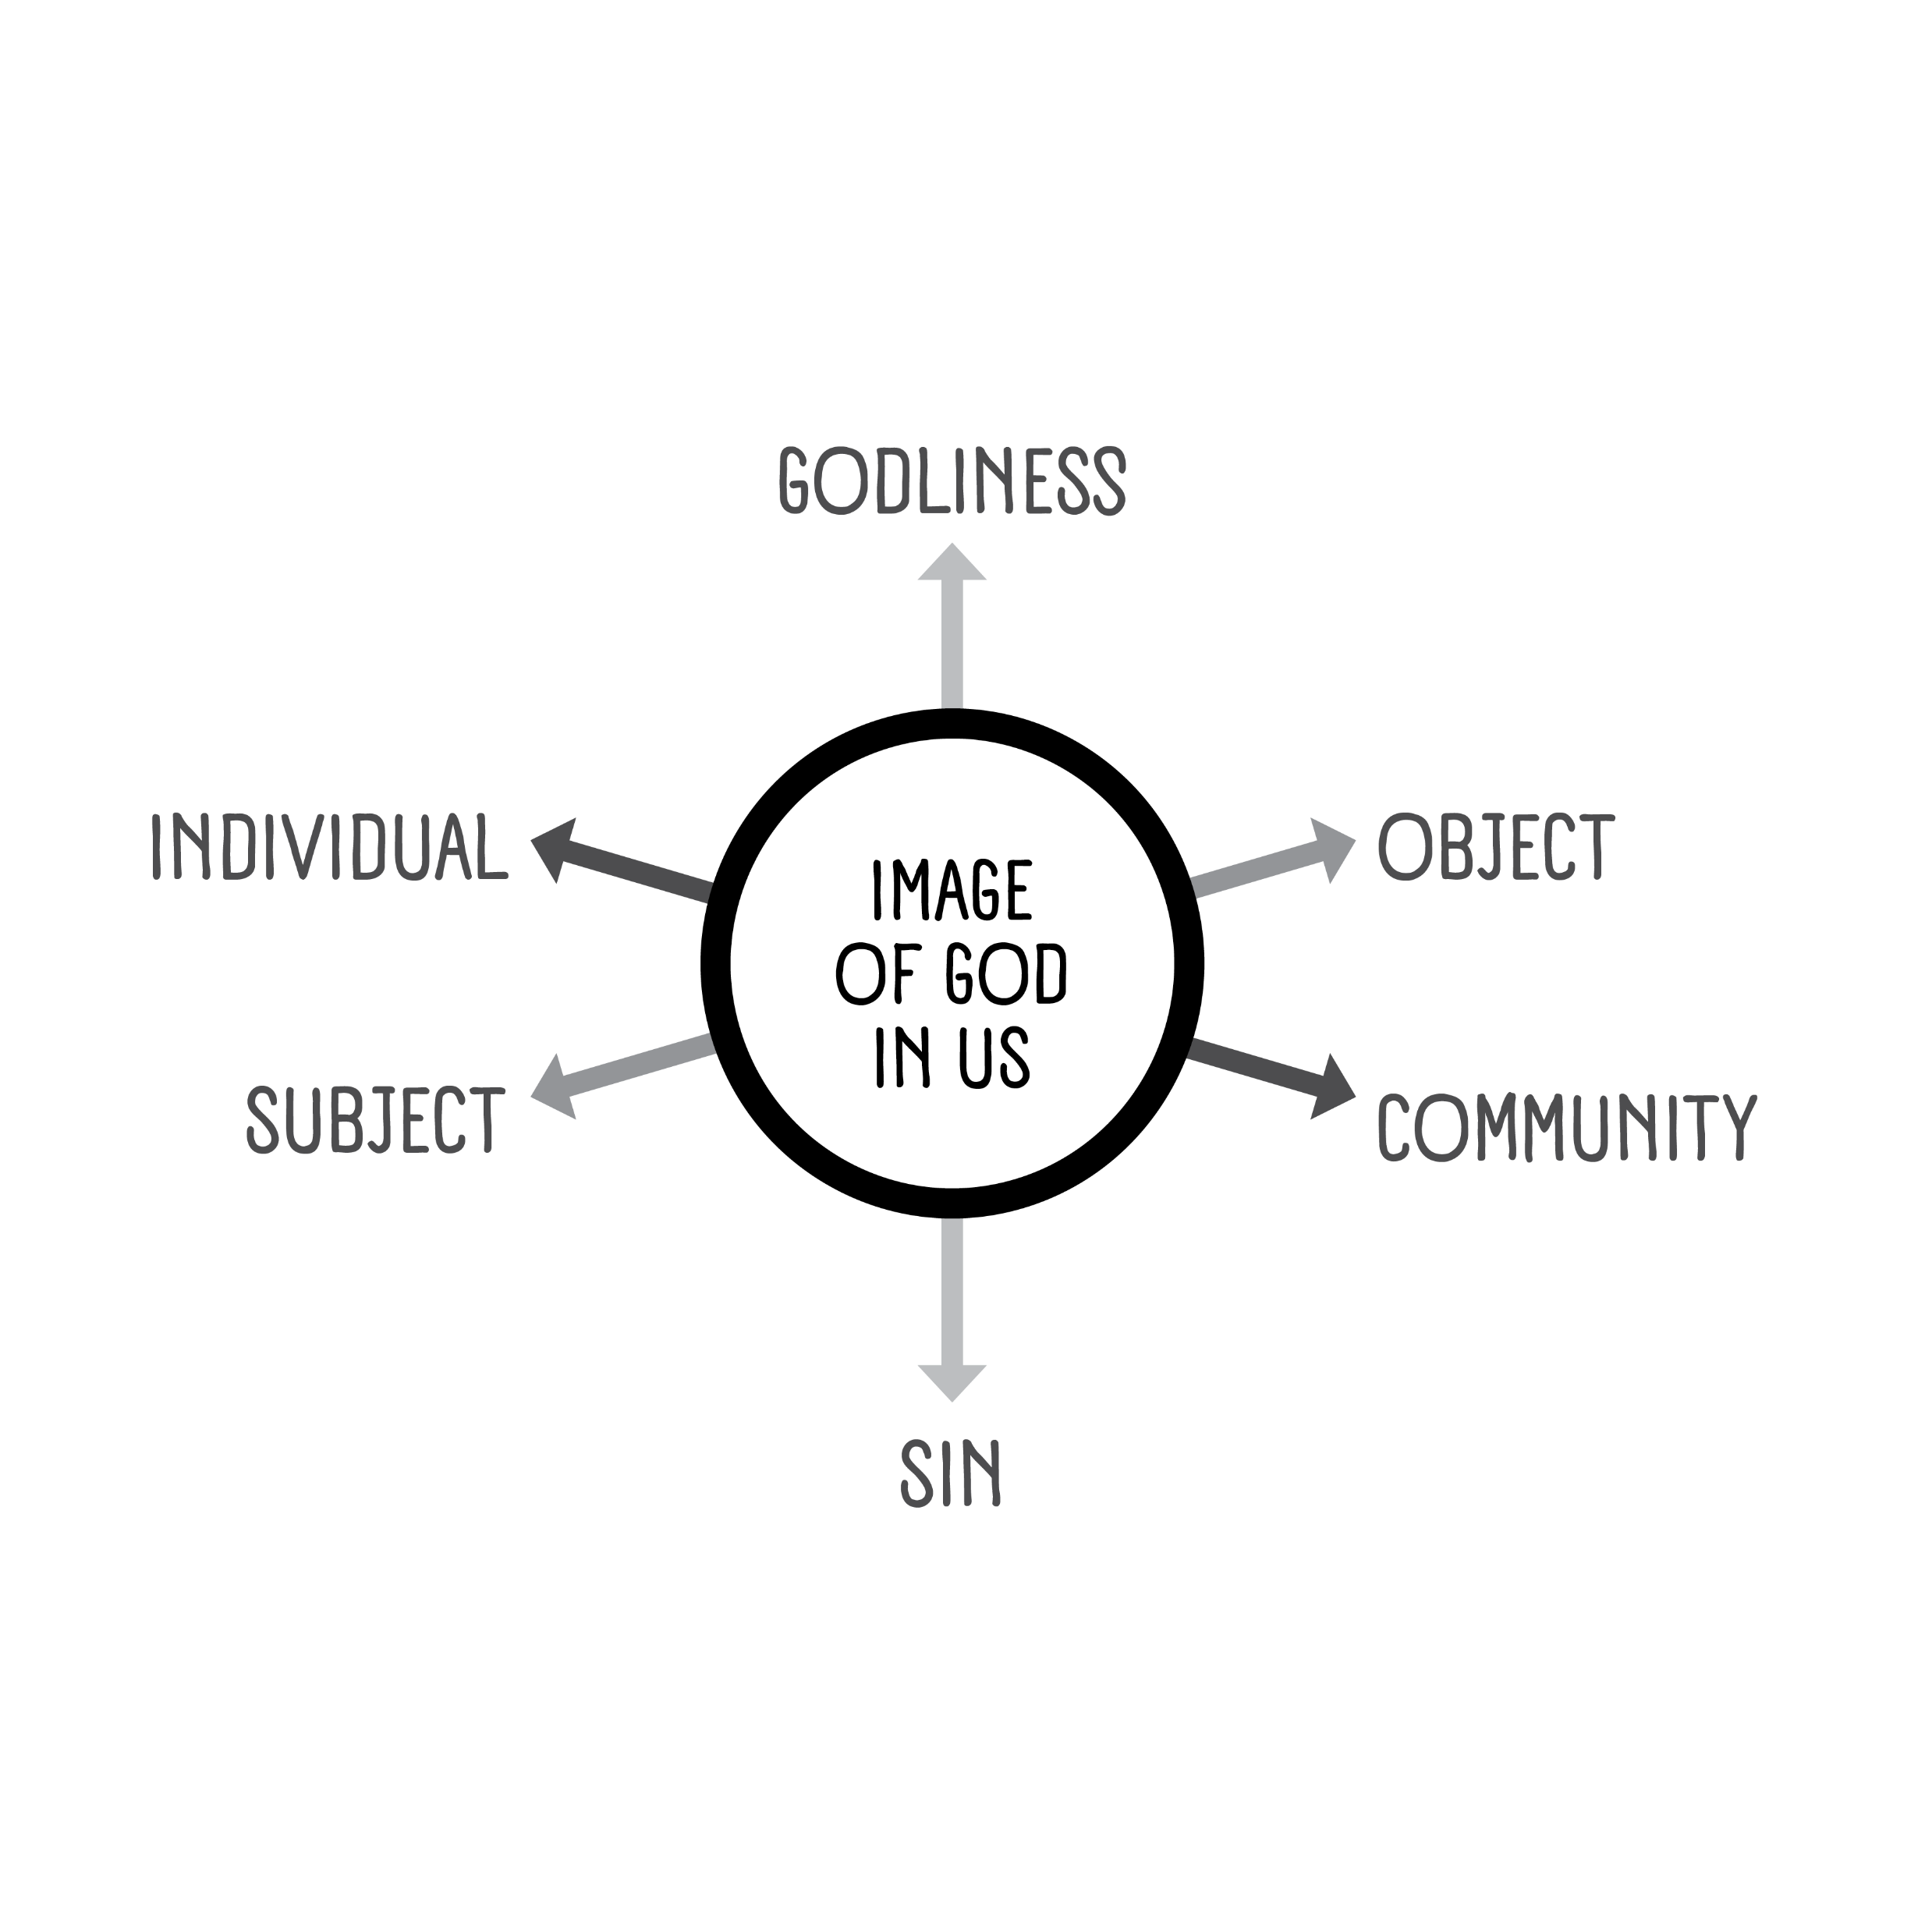
The Three Tensions
Tension 1: Christlikeness vs. Sin
Tension 2: Subject vs. Object

Slide 13
What can happen if people lean too far toward the subjective or objective?

Slide 14
The Three Tensions
Tension 1: Christlikeness vs. Sin
Tension 2: Subject vs. Object
Tension 3: Individual vs. Community

Slide 15
Conclusion

Slide 17
LESSON TWO
Does It Matter What Others Think of Us?

Slide 18
We should not shape our identity to meet the expectations of others.
People cannot see who we are on the inside.

Slide 19
People’s expectations change and contradict.

Slide 20
Our outer characteristics are unreliable, and they will change over time.

Slide 21
We may lose our sense of self if we try to meet others’ expectations.

Slide 22
Character is more important than popularity or acceptance.

Slide 23
Why would we ever think that anyone else’s opinion of us could be more important than God’s?

Slide 24
Character is more important than popularity or acceptance.
God’s values are most important because of who He is.
God loves unconditionally.

Slide 25
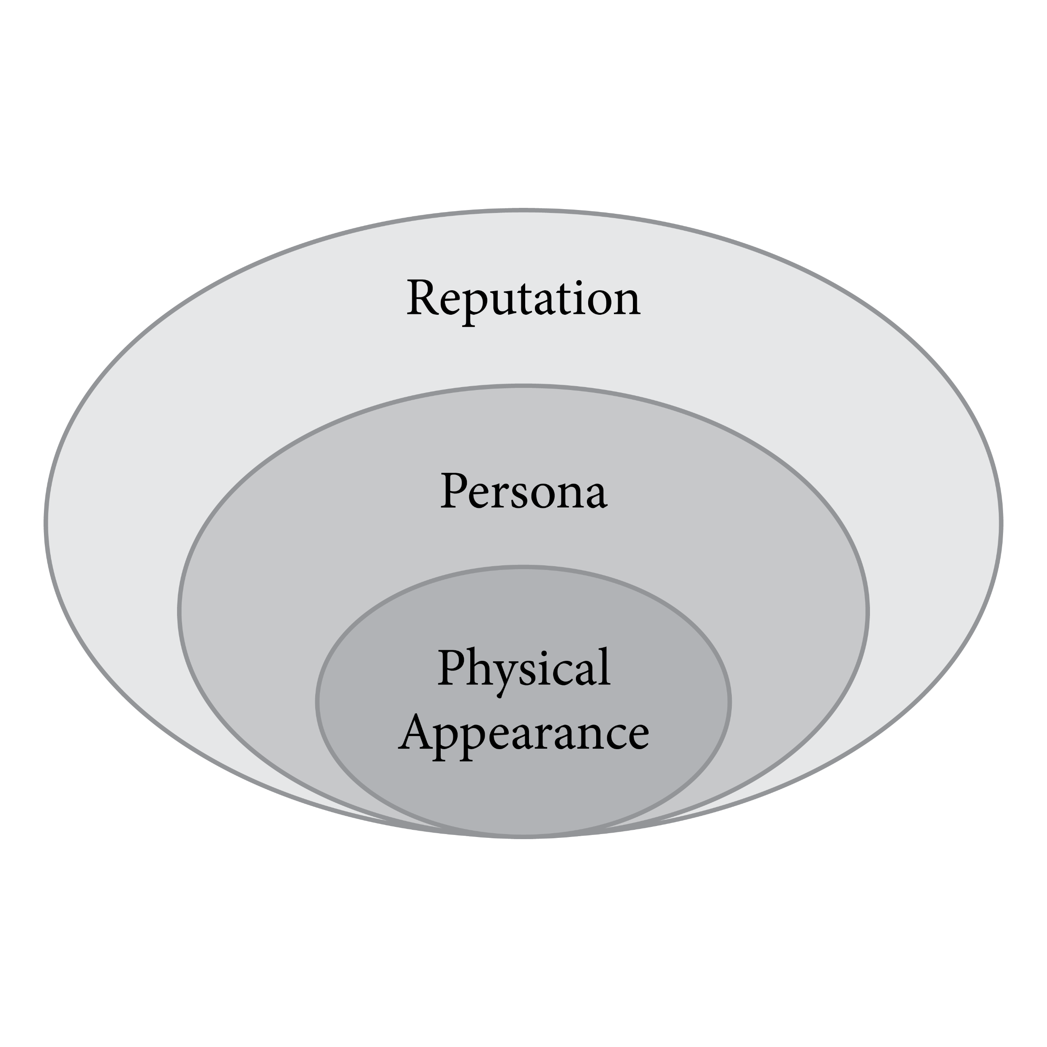
We can show love by the way we present ourselves.
We can manage our physical appearance.

Slide 26
How do we know what is appropriate dress for the setting we’re in?
Would it be wrong to wear a tuxedo to church?
What about wearing pajamas to a funeral?
What principles do we follow?

Slide 27
We can show love by the way we present ourselves.
We can manage our physical appearance.
We can manage our persona.

Slide 28
Why do people act differently online or on social media than they do in person?
Is it OK to have a persona online that’s different from real life?
What differences are understandable—and what differences go too far?
What parts of social media should we view with doubt?

Slide 29
We can show love by the way we present ourselves.
We can manage our physical appearance.
We can manage our persona.
We can steward our reputation.

Slide 30
What are some possible benefits of having a good reputation?

Slide 31
We can show love by the way we present ourselves.
We can manage our physical appearance.
We can manage our persona.
We can steward our reputation.

Slide 32
Conclusion

Slide 34
LESSON THREE
Our Background and Identity

Slide 35
What unique traditions or customs does your family observe during a holiday?

Slide 36
Our Background Influences
There are certain parts of ourselves we cannot change.
Ethnicity
Family of Origin

Slide 37
Not everyone belongs to a family that serves God together. Where else can a believer find belonging?

Slide 38
Our Background Influences
There are certain parts of ourselves we cannot change.
Ethnicity
Family of Origin
Culture

Slide 39
What different things are part of our culture?

Slide 40
Our Background Influences
There are certain parts of ourselves we cannot change.
Ethnicity
Family of Origin
Culture
Background influences don’t dictate our future.
Wisdom helps us discern between what we can control and what we can’t.

Slide 41
How did family background affect people in Scripture?
Moses’ ethnicity was Hebrew, but his culture was Egyptian.
Moses made wrong choices.
Moses moved and found a new family.

Slide 42
What’s more important than our family background?

Slide 43
Conclusion

Slide 45
LESSON FOUR
Sex, Gender, and Identity

Slide 46
Gender and the Beginning
Sex is a category.

Slide 47
In what ways can men specifically help women?
In what ways can women specifically help men?

Slide 48
Gender and the Beginning
Sex is a category.
Gender is an expression.

Slide 49
So what sorts of things fall into this concept of gender?

Slide 50
Think about different jobs traditionally held by men or women—or differences in fashion, activities, or hobbies.
How have these changed, historically?
What has stayed the same?
When do people tolerate exceptions to the norm?

Slide 51
Gender and the Fall

Slide 52
Gender and the Gospel
Our differences are still valuable.
Our similarities outweigh our differences.

Slide 53
Can men learn from women in Scripture?
Can women learn from men?

Slide 54
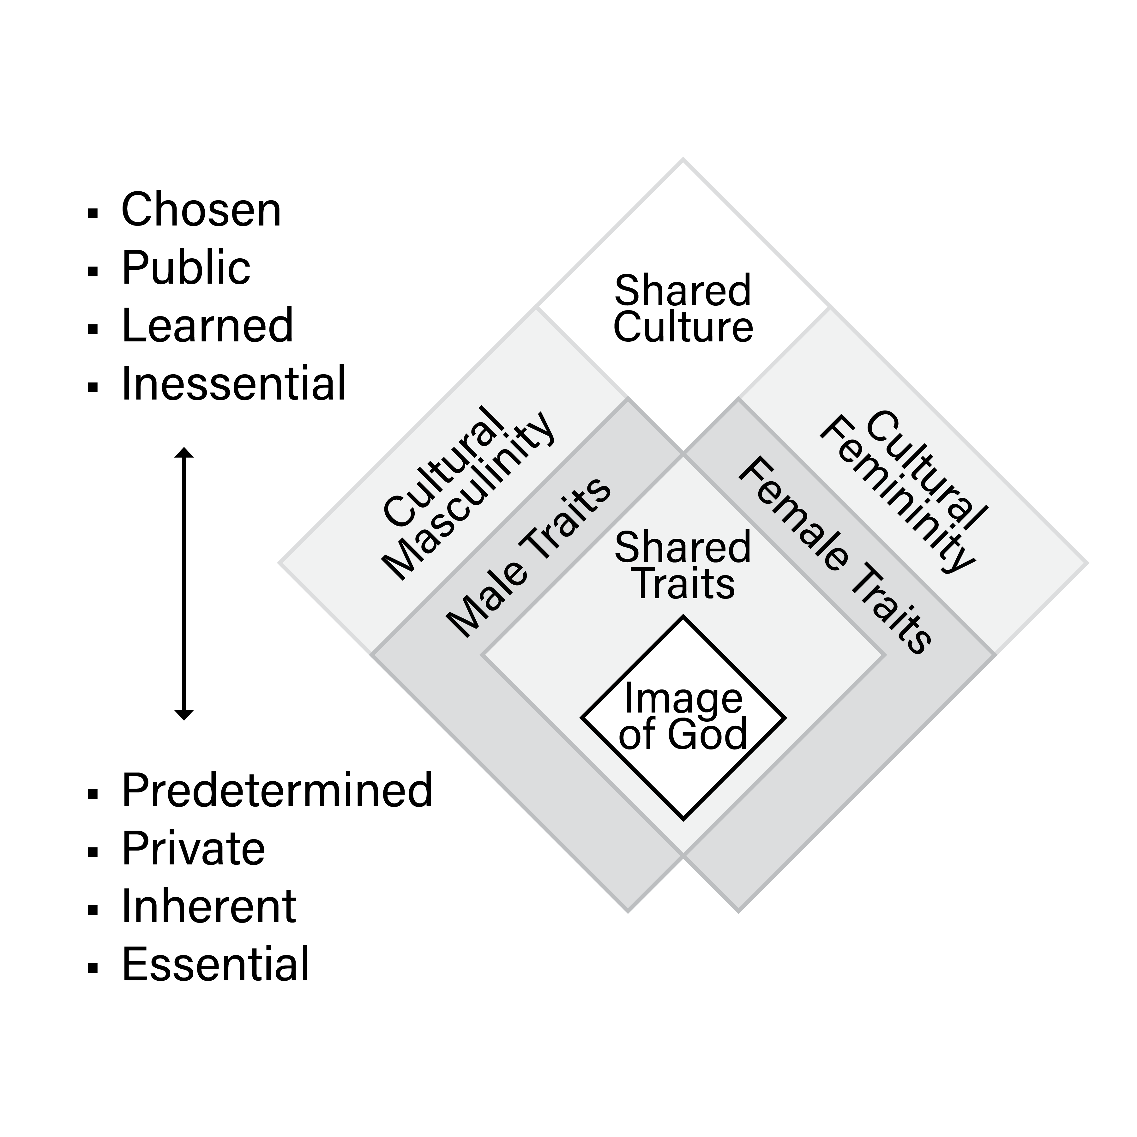
Gender and the Gospel
Our differences are still valuable.
Our similarities outweigh our differences.
Cultural expectations still present a challenge.

Slide 55
Can you think of anyone else in the Bible who perhaps stepped outside of gender roles?

Slide 56
How much should we follow or respect our culture’s expectations for our given sex?
What principle should guide us?

Slide 57
Conclusion

Slide 59
LESSON FIVE
Broader Community and Our Identity

Slide 60
What are some examples of modern-day national and ethnic communities?
What about religious communities?
Are there other types of communities that are common today?
What are some groups or clubs that you belong to?

Slide 61
Our Need for Community

Slide 62
Guidelines for Choosing Community

Slide 63
If a community forms around a morally neutral, shared interest—like cross-country skiing or the 1965 Ford Mustang—is that a good or bad thing?
How can you decide?

Slide 64
Don’t let communities define your entire identity.

Slide 65
What are some drawbacks to our earthly communities?

Slide 66
Don’t let communities define your entire identity.
Earthly communities are temporary.
Earthly communities may lead to division and isolation.
Earthly communities change.

Slide 67
Remember your most important Community.
Our citizenship is spiritual.
We are ambassadors for Christ.
We can fellowship with a community of believers.

Slide 68
Conclusion

