Slide 1
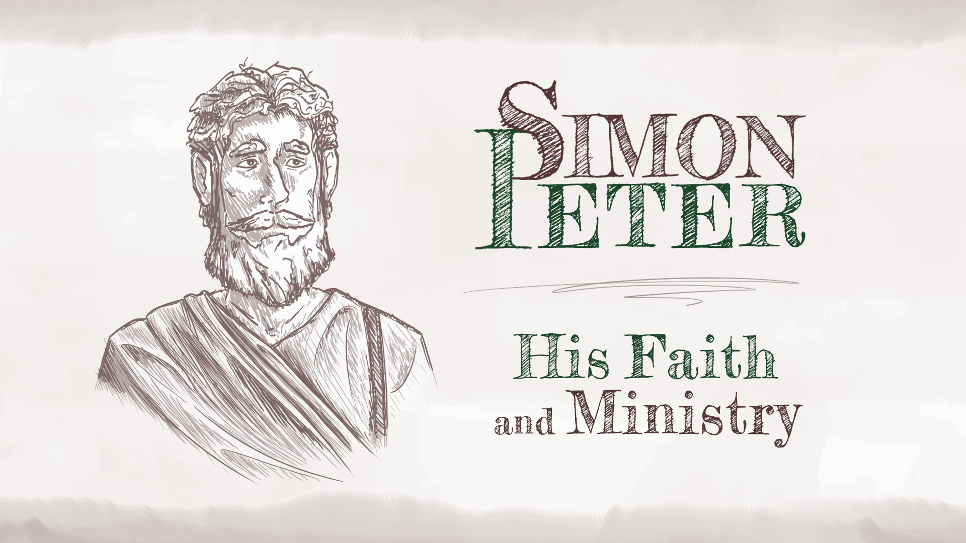

Slide 2

LESSON 1
Who Was Peter?

Slide 3
Peter was a fisherman before he became a disciple.

Slide 4
What miracle did Jesus perform?
How did Peter respond to Jesus’ miracle?
What career change did Jesus have for Peter and his fellow fishermen?

Slide 5
Peter was a leader among the disciples.

Slide 6
Peter was a faithful follower of Jesus who sometimes experienced doubt.

Slide 7
Did Peter demonstrate faith or doubt?
Why did Peter doubt?

Slide 8
Can you describe a challenging time when you found it difficult to trust the Lord?
What would you do or say to encourage a friend in a similar situation?

Slide 9
Closing

Slide 10


Slide 11
LESSON 2
Peter’s Highs
and Lows

Slide 12
High: Peter was among the first to recognize that Jesus had a special relationship with God the Father.

Slide 13
What are some of the miracles
Jesus performed?

Slide 14
High: Peter was among the first to recognize that Jesus had a special relationship with God the Father.

Slide 15
Low: Jesus rebuked Peter.

Slide 16
High: Peter proclaimed his loyalty to Jesus.

Slide 17
How could a Christian be overconfident in their spirituality or in their perceived commitment to Christ?

Slide 18
Low: Peter denied Jesus three times after falling asleep when he should have been praying.

Slide 19
Have you ever experienced pressure to choose between following Jesus or distancing yourself from Him?
What did you do?

Slide 20
Closing

Slide 22
LESSON 3
Peter’s Recommissioning

Slide 23
What have you learned about Peter so far in our study together?

Slide 24
Jesus appeared to the disciples and gave them encouragement and instructions.
Jesus gave the disciples peace.

Slide 25
Have you ever had a broken relationship that you wanted to see restored?

Slide 26

Jesus appeared to the disciples and gave them encouragement and instructions.
Jesus gave the disciples peace.
Jesus gave the disciples the Holy Spirit.
The Holy Spirit…
Convicts
Baptizes
Indwells
Seals
Sanctifies
Fills
Assures
Prays
… and more

Slide 27
Jesus appeared to the disciples and gave them encouragement and instructions.
Jesus gave the disciples peace.
Jesus gave the disciples the Holy Spirit.
Jesus gave the disciples a mission to preach the gospel.

Slide 28
Jesus appeared to the disciples and recommissioned Peter.

Slide 29
Have you ever felt like you were
unfit to serve Jesus?
How might Peter’s experience
encourage you?

Slide 30
Closing

Slide 32
LESSON 4
Peter’s Bold Witness for Christ

Slide 33
Peter preached to a crowd, and 3,000 people were saved.

Slide 34
Have you ever witnessed something so amazing that you had to tell others about it? What was it?
What are some amazing things about Jesus and the gospel that are worth sharing with others?

Slide 35
Peter was arrested for preaching the gospel.

Slide 36
At different times and in different places, sharing the gospel has been forbidden.
What should Christians do in situations where it’s illegal to share the gospel?

Slide 37
Peter was arrested for preaching the gospel.

Slide 38
Peter performed miracles.
Peter and the apostles healed
many people.

Slide 39
Do people recognize you as a follower of Jesus? Others may not suspect you of being an evil person, but would others consider you a faithful follower of Jesus?
Do you spend time with the Lord?
Are you actively serving God?

Slide 40
Peter performed miracles.
Peter and the apostles healed
many people.
Peter healed Aeneas.

Slide 41
What are some good things that believers can do to serve others?
Do you ever thank the Lord for doing good things through other people?

Slide 42
Peter performed miracles.
Peter and the apostles healed
many people.
Peter healed Aeneas.
Peter raised Dorcas from the dead.

Slide 43
Have you ever helped to meet a
physical need?
Have you ever helped someone
with a spiritual need?

Slide 44
Closing

Slide 46
LESSON 5
Peter’s Ministry in the Early Church

Slide 47
God called Peter to take the gospel to the Gentiles.

Slide 48
How do you think a Jew would respond to an invitation from a Gentile?

Slide 49
God called Peter to take the gospel to the Gentiles.

Slide 50
God delivered Peter from prison.

Slide 51
Have you ever been encouraged to learn that others were praying for you?
Are you currently praying for someone who is going through some difficulty?

Slide 52
God used Peter to write Scripture.
1 Peter

Slide 53
What are some trials and difficulties believers face today?

Slide 54
God used Peter to write Scripture.
1 Peter
2 Peter

Slide 55
2 Peter 1:5–8
Faith
Virtue / Goodness / Moral Excellence
Knowledge
Temperance / Self-control
Patience / Perseverance / Steadfastness
Godliness
Brotherly Kindness / Mutual Affection / Brotherly Affection
Charity / Love

Slide 56
What is one quality from this list that you would like to implement better?
What are some steps you can take to make that happen?

Slide 57
What happened to Peter?

Slide 58
Closing

